Slide 1
Protocol Hierarchies

Slide 2
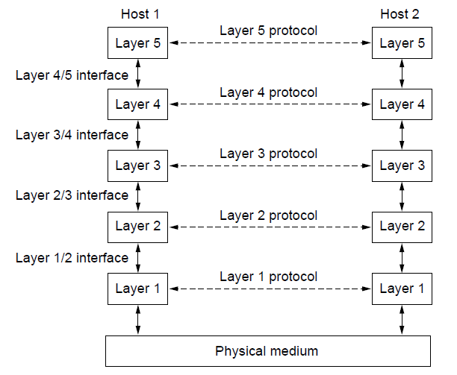
Protocol Hierarchies
Layering:
The main method used to divide network functionality
Protocols logically talk to each other
But actually communicate using the layer below
Lower layer services are accessed through an interface
Bits are carried by the medium at the bottom

Slide 3
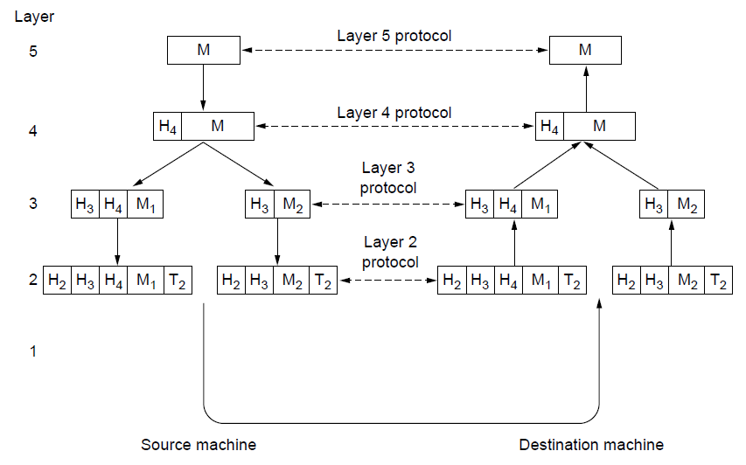
Protocol Hierarchies (3)
Transmission: Each layer adds a header (with control information specific to the protocol at this layer)
Reception: Headers Removed
A layer may also split (fragment) or re-assemble messages

Slide 4
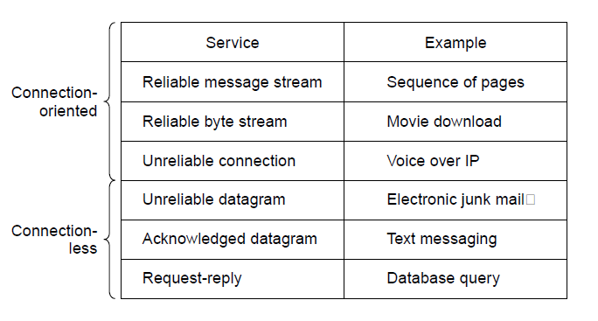
Connection-Oriented Versus Connectionless Service
Connection-oriented: Must be set up before use and terminated afterwards
Connectionless: Each message normally handled separately

Slide 5
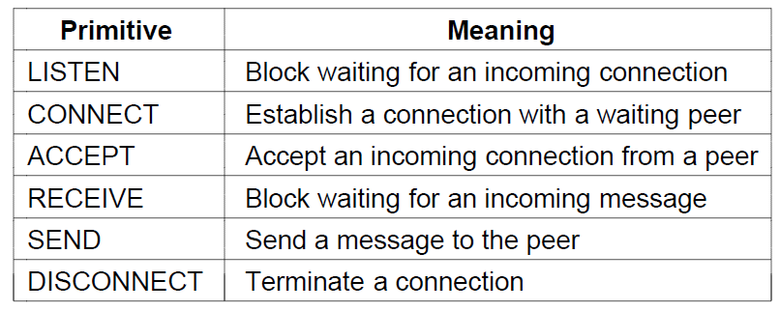
Service Primitives (1)
A layer provides a service to the one above using primitives
Six service primitives that provide a simple connection-oriented service

Slide 6
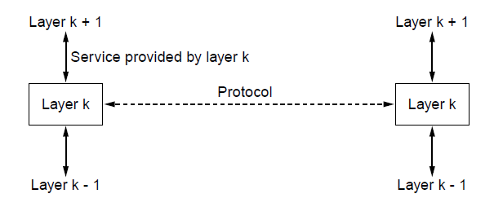
Service / Protocol Relationship

